Slide 1

EDA PROJECT ON AMAZON SALES DATASET
By
P. Tejaswini
Batch434

Slide 2
PROJECT OBJECTIVE :
The main objective of this project is to perform Exploratory Data Analysis (EDA) on the Amazon Sales dataset to understand overall sales performance.
It focuses on analyzing revenue, profit, and product trends across different regions and categories.
The project involves data cleaning, visualization, and summarization using Python libraries like Pandas, NumPy, Matplotlib, and Seaborn.
Through various charts and plots, we aim to identify top-selling products, regional performance, and sales distribution patterns.
The insights obtained help in making data-driven decisions to improve business growth and profitability.

Slide 3

PROBLEM STATEMENT :
Amazon generates a large volume of sales data from different products, categories, and regions.
It is difficult to identify which products or regions contribute the most to total sales and profit.
There is a need to understand sales trends over time to plan inventory and marketing strategies effectively.
The dataset contains raw and unorganized data that must be cleaned and analyzed for better insights.
The main problem is to analyze and visualize the sales data to uncover key patterns, trends, and business insights.
This analysis will help in data-driven decision-making and improving overall business performance.
The key challenges addressed in this project include:
The key challenges addressed in this project include:
Identifying trends in monthly sales to understand seasonal demand fluctuations.
Analyzing sales distribution across different regionsacross different regions to identify high-performing and underperforming areas.
Evaluating product performance to determine the top revenue-generating products and those with high sales volumes.
Predicting order priorities to optimize inventory management and logistics, ensuring timely delivery and customer satisfaction.
Understanding correlations beeen different sales factors to make data-driven business decisions.

Slide 4
INTRODUCTION :
Amazon is one of the world’s largest e-commerce platforms with vast sales data collected from multiple products and regions.
Analyzing this data helps understand sales patterns, customer preferences, and business performance.
The project focuses on performing Exploratory Data Analysis (EDA) on the Amazon Sales dataset using Python.
Through data cleaning, transformation, and visualization, the goal is to extract valuable insights from raw data.
Various tools and libraries such as Pandas, NumPy, Matplotlib, and Seaborn are used for the analysis.
The analysis aims to identify top-selling products, revenue trends, and profit distribution across regions.
The insights from this project can support strategic decision-making and business growth.

Slide 5

DATASET :
The dataset used in this project contains detailed information on Amazon sales transactions. It includes essential attributes such as region, country, item type, sales channel, order and ship dates, units sold, pricing details, and financial metrics like total revenue, total cost, and total profit. Each row represents one complete sales transaction, making the dataset useful for analyzing sales patterns, product performance, and overall profitability.
This dataset consists of 100 rows and 14 columns, providing a compact but meaningful sample of Amazon’s sales records. During the initial data audit, the dataset was thoroughly checked for quality issues. The analysis showed that the dataset contains no missing values, ensuring that all records are complete and usable. Additionally, no duplicated entries were found, indicating that each transaction is unique. However, the numerical columns such as Units Sold, Unit Price, Total Revenue, and Total Profit displayed the presence of outliers, which were identified through boxplots and statistical measures. These outliers were further analyzed in the exploratory data analysis phase.

Slide 6
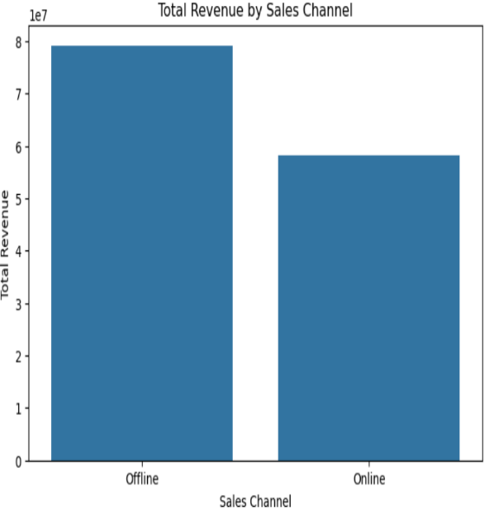
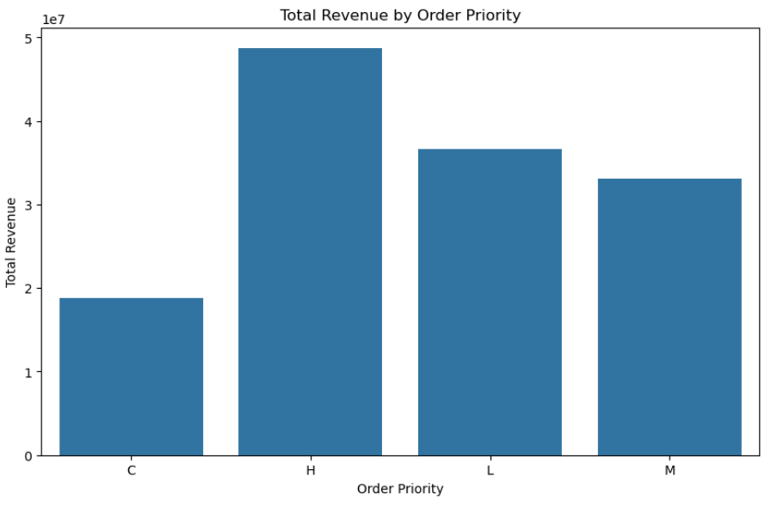
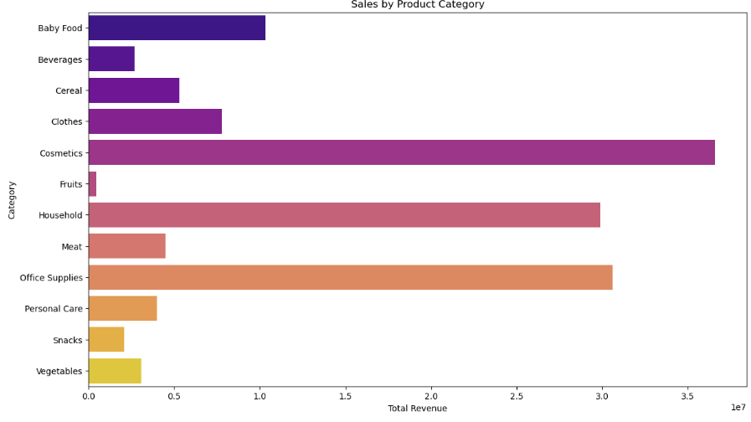
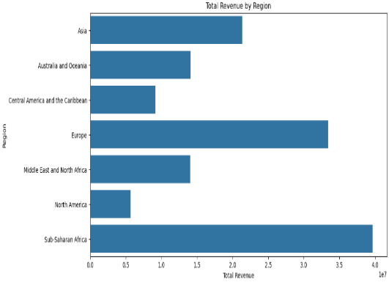
VISUALIZATION :
After analyzing our Amazon Sales dataset, the next step is to represent the data through meaningful visualizations. These visual insights help us easily identify trends, patterns, and relationships within the dataset. By using different types of charts, we can better understand sales behavior, customer preferences, and overall business performance.
Visualizations make it easier to interpret the data and extract actionable insights that support decision-making, improve product strategies, and enhance sales outcomes on Amazon.
Below are some sample visualizations developed from the dataset:

Slide 7

TOTAL REVENUE BY REGION :
The Total Revenue by Region analysis clearly shows unequal revenue distribution across global markets. Sub-Saharan Africa generated the highest revenue at approximately 40 million, indicating strong customer demand and high sales volume in that region. Europe followed with around 33 million, reflecting a mature and stable market.
Asia contributed roughly 22 million, making it another significant region with consistent sales. Middle East and North Africa (15 million) and Australia and Oceania (14 million) showed moderate revenue levels, highlighting regions with steady but developing growth potential.
On the lower side, Central America and the Caribbean accounted for nearly 9 million, while North America contributed about 6 million. These regions may benefit from improved marketing strategies, aggressive promotions, or targeted product expansion.
This regional revenue comparison helps identify top-performing markets and highlights areas where strategic interventions could boost overall sales.

Slide 8

TOTAL REVENUE BY SALES CHANNEL :
The analysis of Total Revenue by Sales Channel shows a clear difference in performance between Online and Offline sales. The Offline channel generated the highest revenue at approximately 80 million, indicating strong customer engagement in physical or traditional retail environments. This suggests that offline buyers contribute significantly to total sales, possibly due to product visibility, direct customer interaction, or established retail presence.
The Online channel generated around 58 million, which is also a substantial figure but lower compared to offline sales. This reflects steady digital activity and highlights the growing adoption of online shopping platforms. However, the gap indicates that there is still room to enhance online strategies through improved user experience, targeted promotions, or better digital marketing.

Slide 9
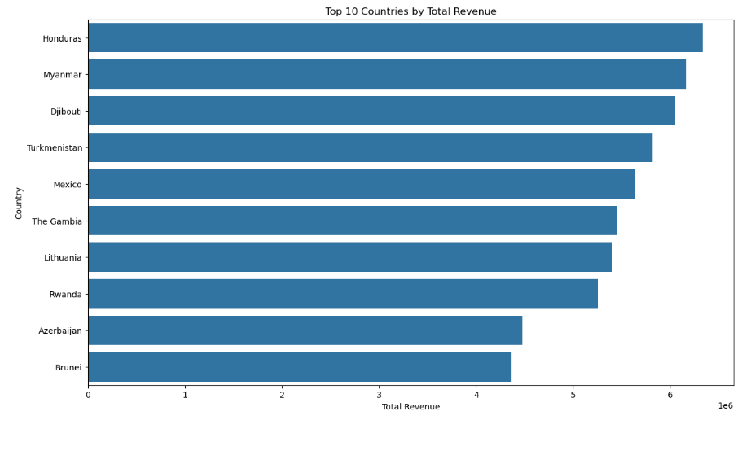
Top 10 countries by Total Revenue
This chart highlights the top 10 countries that generated the highest total revenue in the dataset. Honduras leads with the maximum revenue, followed closely by Myanmar and Djibouti, indicating strong sales performance in these regions. Countries like Turkmenistan, Mexico, and The Gambia also contributed significantly, showing steady demand. The remaining countries—Lithuania Rwanda, Azerbaijan, and Brunei—complete the top 10 list with competitive revenue levels. Overall, the visualization shows that revenue varies widely across countries, with a few regions dominating sales performance.

Slide 10
Total Revenue by Order Priority
1. High Priority (H) orders generate the most revenue
This means:
-- Most of the money comes from orders marked as “High Priority”
-- Customers placing high-priority orders buy more or more expensive items
-- These orders contribute strongly to the company’s sales performance
2. Low Priority (L) orders also produce high revenue
This tells us:
-- Even non-urgent orders bring in strong and stable sales
-- Customers are regularly purchasing items without urgency
3. Medium Priority (M) orders are slightly lower
Meaning:
-- They bring in decent revenue, but not as much as high or low-priority orders
-- Demand is moderate for this order type
4. Critical Priority (C) orders generate the lowest revenue
This suggests:
-- Very few extremely urgent orders are placed
OR
-- These orders have lower quantities or lower prices
-- Customers rarely choose critical priority when buying
Simple Understanding in One Line :
The company earns the most money from high-priority orders and the least from critical-priority orders.

Slide 11
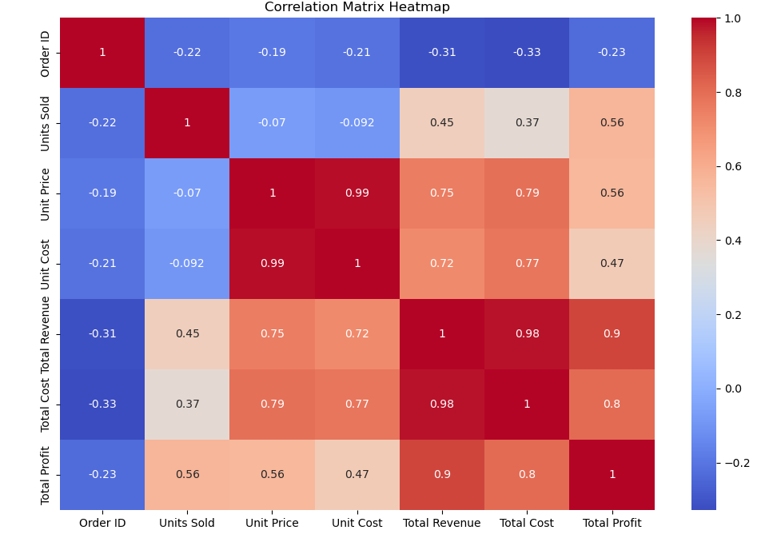
Heatmap for Correlation :
This visualization is a heatmap that illustrates the correlation between different numerical variables in the dataset. Each cell in the heatmap represents the correlation coefficient between two variables, with the values ranging from -1 to 1. The color intensity indicates the strength and direction of the correlation, with darker colors representing stronger correlations.
Insights:
Correlation Strength: The heatmap allows for quick identification of strong positive correlations (closer to 1) and strong negative correlations (closer to -1) between variables. Cells with colors closer to the extreme ends of the color scale indicate these strong correlations.
Positive and Negative Correlations: Positive correlations imply that as one variable increases, the other tends to increase as well. Negative correlations suggest that as one variable increases, the other tends to decrease. Neutral correlations (close to 0) indicate little to no linear relationship.
Data Patterns: The heatmap helps in spotting patterns and relationships that might not be immediately evident, providing a comprehensive view of how different variables interact.

Slide 12
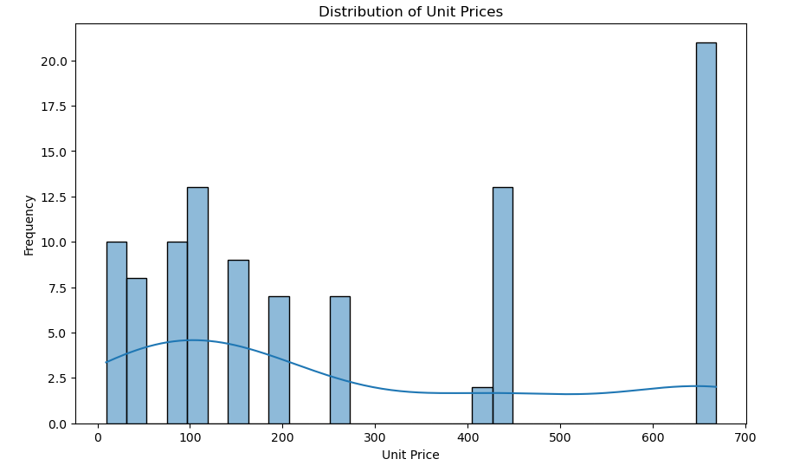
Distribution of Unit Prices :
This visualization displays the distribution of unit prices for the items sold. It can be represented as a histogram, density plot, or box plot, showing how unit prices are spread across the dataset. The horizontal axis represents the unit price, while the vertical axis indicates the frequency or density of the items at different price points.
Insights:
Price Range: The chart shows the range of unit prices, highlighting the minimum and maximum prices in the dataset.
Price Distribution: It provides a clear view of how unit prices are distributed, indicating whether most items are clustered around a particular price range or spread out across a wide range.
Central Tendency: The visualization helps in identifying measures of central tendency, such as the mean, median, and mode of the unit prices.
Skewness and Kurtosis: It reveals the skewness of the distribution (whether the prices are skewed to the left or right) and the kurtosis (the peakedness or flatness of the distribution), providing insights into the variability and concentration of unit prices.

Slide 13
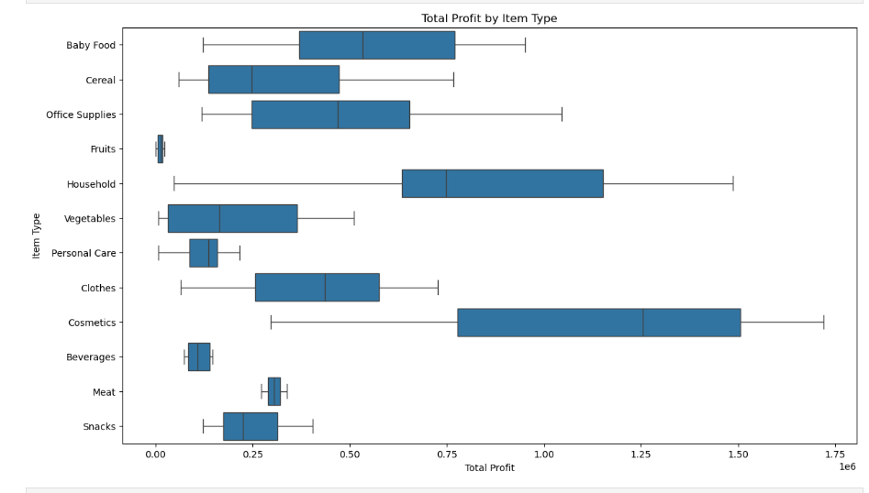
Box Plot of Total Profit by Item Type :
This visualization is a box plot that shows the distribution of total profit for different item types. Each box represents the total profit data for a specific item type, displaying key statistics such as the median, quartiles, and potential outliers.
Insights:
Profit Distribution: The box plot reveals how total profit is distributed across different item types, highlighting the range and variability of profits within each category.
Central Tendency: The line within each box indicates the median total profit for that item type, providing a measure of central tendency.
Quartiles: The edges of the box represent the first (Q1) and third (Q3) quartiles, showing the interquartile range (IQR) where the middle 50% of the data lies. This helps in understanding the spread and skewness of the data.
Outliers: Points outside the "whiskers" of the box plot are considered outliers, indicating item types with unusually high or low total profits. These outliers can provide insights into exceptional cases or opportunities for further investigation.
Comparative Analysis: By comparing the boxes, one can identify which item types are more profitable and which ones have higher variability in profits.

Slide 14
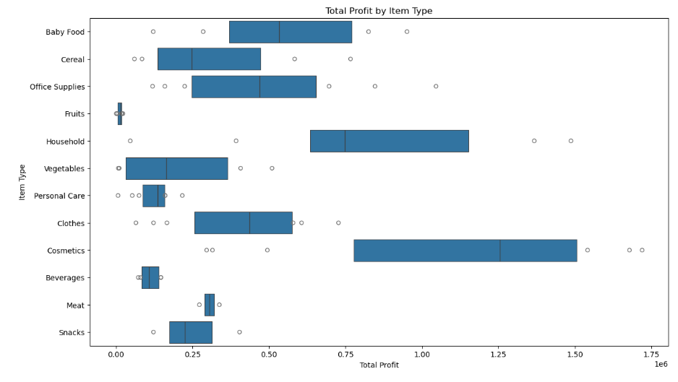
Difference Between Box Plot and Boxen Plot
A box plot shows the basic distribution of your data.
It highlights:
-- Median (center value)
-- Quartiles (25%, 50%, 75%)
-- Whiskers (data range)
-- Outliers (dots)
In your dataset:
-- If you made a box plot for Total Profit, it would show:
-- The median profit for each item type
-- The spread of profit values
-- Outliers (very high or low profit transactions)
Boxen Plot (Enhanced Box Plot)
A boxen plot is also called a “letter-value plot.”
It shows much more detail, especially when you have:
-- Wider ranges
-- Skewed data
-- Many outliers
-- Large variation
In your dataset:
-- Your “Total Profit by Item Type” boxen plot reveals:
-- More detailed layers of the profit distribution
-- How the profit values gradually spread from lower to higher ranges
-- Better visibility of categories like Cosmetics, Household, Office Supplies, which have wide or uneven distributions
-- More clear identification of profit extremes

Slide 15
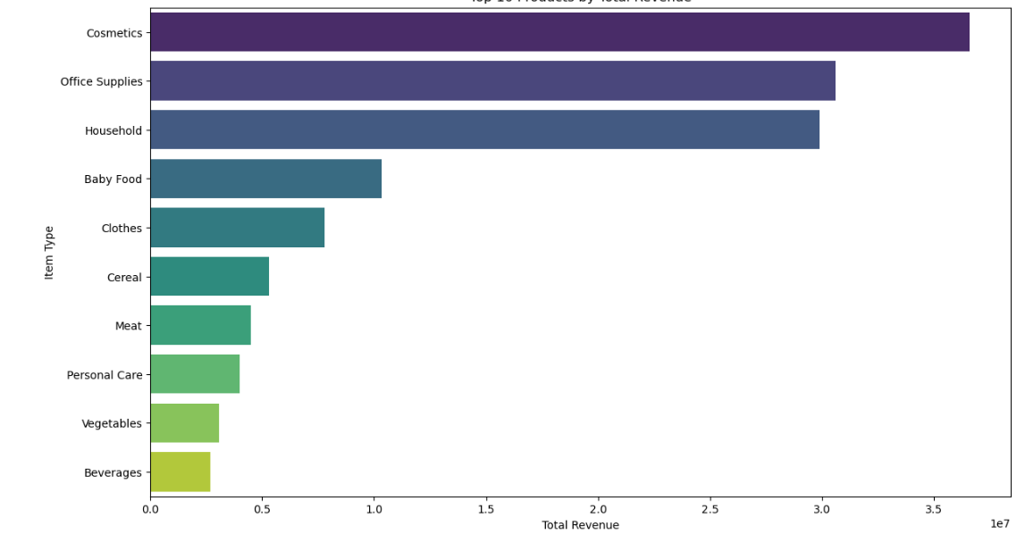
Top 10 Products by Total Revenue :
This visualization displays the top 10 products ranked by their total revenue generated from sales. Each product is represented on the horizontal axis, while the vertical axis indicates the total revenue in monetary units.
Insights:
Revenue Leaders: The chart highlights the top 10 products with the highest revenue, providing a clear view of the best-selling items.
Revenue Distribution: By comparing the heights of the bars, we can see the distribution of revenue among the top-performing products, identifying which items are the most lucrative.
Product Performance: Understanding which products generate the most revenue helps in identifying key products that drive the majority of sales.
Market Demand: High-revenue products are indicative of strong market demand, offering insights into consumer preferences and popular items.

Slide 16
Sales by Product Category:
This visualization depicts the total sales for each product category. The horizontal axis represents the different product categories, while the vertical axis indicates the total sales in monetary units. Each bar represents the aggregate sales figures for a specific product category.
Insights:
Sales Distribution: The chart shows how sales are distributed across various product categories, highlighting which categories generate the most revenue.
Top Categories: Product categories with higher bars are the top-performing ones in terms of sales, indicating high consumer demand and popularity.
Comparative Analysis: By comparing the heights of the bars, we can easily see the differences in sales performance between categories, helping to identify both strong and underperforming segments.
Market Trends: Understanding sales by product category provides insights into market trends and consumer preferences, guiding business decisions.

Slide 17
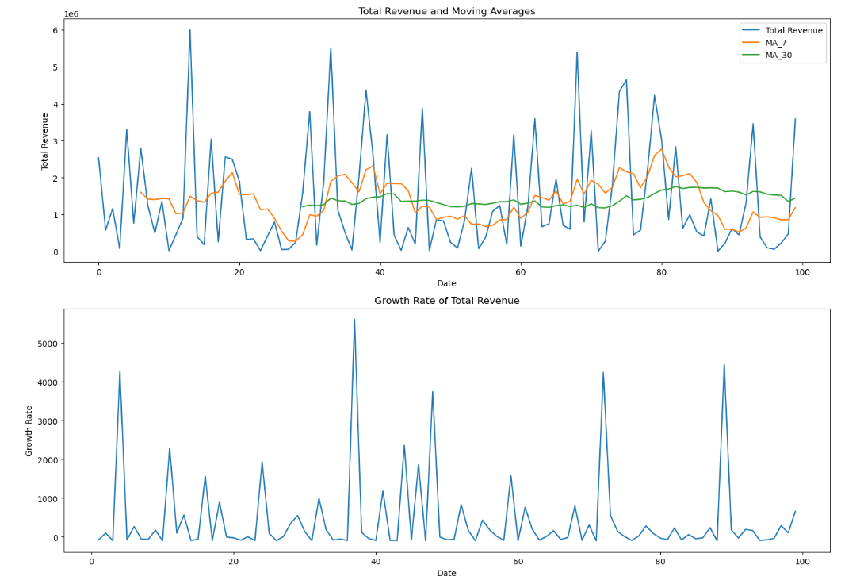
Advanced Feature Engineering With Visualizations :
This section focuses on advanced feature engineering techniques, utilizing visualizations to enhance data preprocessing and model building. Feature engineering involves creating new features or transforming existing ones to improve the performance of machine learning models. Visualizations play a crucial role in understanding data patterns, relationships, and distributions, guiding the creation of more informative and predictive features.
Insights:
Feature Correlation: Visualizations such as heatmaps can show correlations between features, helping to identify redundant features or strong relationships that can be leveraged to create new features.
Distribution Analysis: Histograms, density plots, and box plots can reveal the distribution of features, highlighting skewness, outliers, and data ranges. This information is vital for normalization, scaling, or transforming features.
Time Series Trends: Line plots and seasonal decomposition charts can help in analyzing trends and seasonality in time series data, guiding the creation of features like moving averages, lags, and seasonal indicators.
Interaction Effects: Scatter plots and pair plots can identify interaction effects between features, suggesting combinations or polynomial features that may improve model performance.

Slide 18
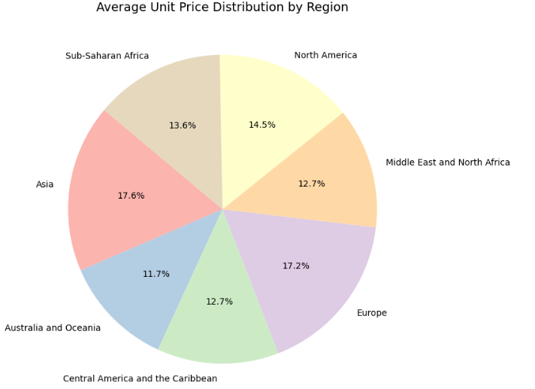
Average Unit Price Distribution by Region :
This pie chart shows how the average unit price of products varies across different regions in the dataset. Each slice represents the percentage share of the average price contributed by each region.
-- Asia has the highest average unit price (17.6%), indicating that products sold in this region are priced higher compared to other regions.
-- Europe (17.2%) and North America (14.5%) also show strong price levels, suggesting higher-value or premium items in these regions.
-- Sub-Saharan Africa (13.6%), Middle East & North Africa (12.7%), and Central America & the Caribbean (12.7%) have moderate average prices.
-- Australia and Oceania (11.7%) has the lowest average unit price, showing that items sold here tend to be cheaper.
Overall, the chart indicates that Asia, Europe, and North America have higher-priced products, while Australia & Oceania and Central American regions tend to have lower average unit prices.

Slide 19
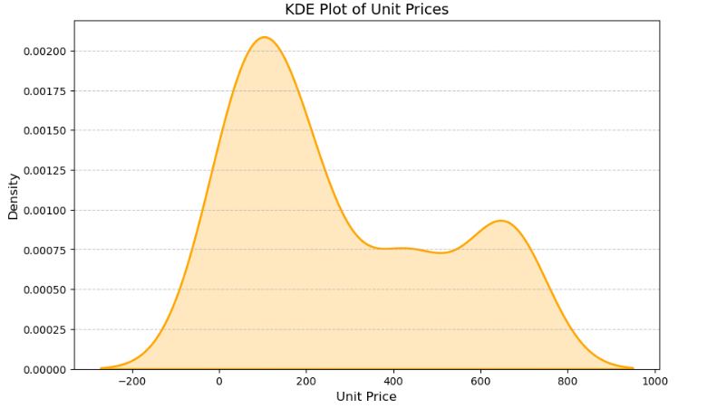
KDE Plot of Unit Prices:
This KDE plot shows how product unit prices are distributed in the dataset. The smooth curve represents the density of prices, helping us understand which price ranges are most common.
The plot peaks around the 100–200 price range, meaning most products are priced within this range.
There is a smaller rise around the 600–700 range, indicating a second group of higher-priced items.
The distribution is right-skewed, showing that while most products are moderately priced, a few items have much higher prices.
The long tail towards the right suggests outliers or premium items with high unit prices.
Very low or negative price values on the left are likely due to data variation or unusual entries.

Slide 20

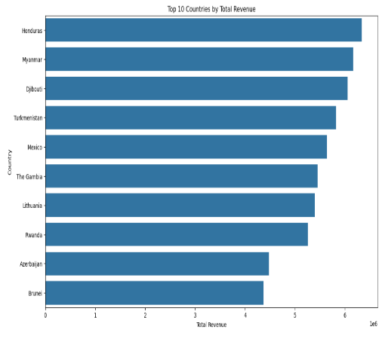
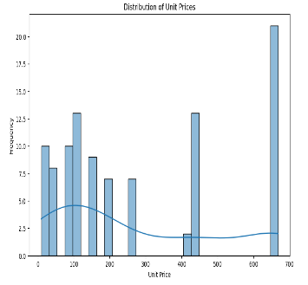


Conclusion :
This project involved a detailed analysis of Amazon sales data, leveraging data exploration, visualization, feature engineering, anomaly detection, and predictive modeling to extract valuable insights. Key findings include:
Data Exploration and Visualization: Visual analyses revealed patterns in total revenue by region, sales channel, and product category, and identified top products and countries by revenue.
Feature Engineering: Advanced techniques improved model predictions by identifying important features and creating new ones based on visual insights.
Anomaly Detection: Statistical methods and machine learning identified data anomalies, ensuring data quality and highlighting unusual patterns.
Predictive Modeling: Models were developed to forecast sales and identify key factors influencing performance. Seasonal decomposition provided deeper insights into trends and patterns.
Actionable Insights: The analysis uncovered significant trends, such as seasonal sales peaks and high-revenue products, informing inventory management, marketing strategies, and resource allocation.

Slide 21
THANK YOU

